Slide 1

ESP32 Wi-Fi RC Car
Integrating Web-Based Control with Real-Time Ultrasonic Obstacle Detection and Safety Systems
Course: Internet of Things
Date: May 2024

Slide 2
Team Members
Mohamed Hamed Ibrahim
Mohamed Mohab Mohamed
Youssef Mohamed Yahya
Youssef Ossama Mohamed
Mahmoud Samir Abd El-Rahim
Omar Mohamed Gamal
Rawan Mohamed Mohamed
Hager Hagag Sayed
Nour Amin Ahmed
Rawan Waled Galal
Mariam Samir Habib

Slide 3




PROJECT OBJECTIVES
Remote Connectivity
Autonomous Safety
Establishing a wireless Access Point on the ESP32 to host a cross-platform web interface for real-time robotic maneuvering without the need for external mobile apps.
Implementing an ultrasonic-based feedback loop to detect environmental barriers and trigger immediate safety stops, preventing physical damage to the robot chassis.

Slide 4
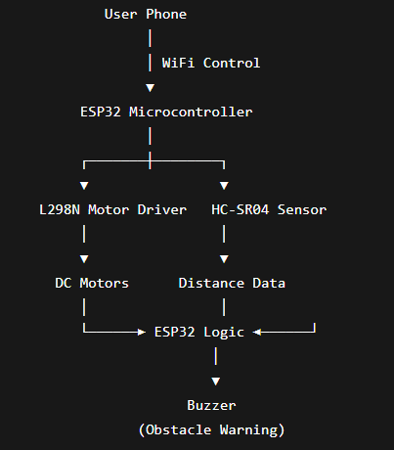
SYSTEM OVERVIEW
Wi-Fi Access Point: The ESP32 creates its own local network, ensuring low-latency communication.
Web-Based UI: A custom HTML5 page featuring a virtual joystick for intuitive touch or mouse control.
Edge Processing: All logic—from parsing joystick coordinates to obstacle math—is performed locally on the ESP32 dual-core chip.

Slide 5
HARDWARE COMPONENTS
Category | Component | Function
Core | ESP32 Microcontroller | Wi-Fi Server & Central Processing Unit
Actuation | L298N Motor Driver + 2 DC Motors | Dual-channel H-Bridge for directional control
Sensing | HC-SR04 Ultrasonic Sensor | Proximity and distance measurement
Security | Active Buzzer | Audible collision alert system
Power | Power Bank (USB) | Stable 5V power supply for electronics

Slide 6






SYSTEM ARCHITECTURE
Control Layer
Processing Layer
Action Layer
User connects to WiFi AP. Phone browser sends X/Y coordinates via HTTP requests.
ESP32 parses data, calculates differential steering, and checks sensor distance.
L298N activates motors based on PWM; Buzzer sounds if safety limit is breached.

Slide 7
WIRING & PIN CONFIGURATION
ESP32 GPIO Pin | Connected Component | Function
GPIO27, GPIO26 | L298N IN1, IN2 | Right Motor Direction Control
GPIO18, GPIO19 | L298N IN3, IN4 | Left Motor Direction Control
GPIO23 | HC-SR04 TRIG | Sends ultrasonic pulse
GPIO32 | HC-SR04 ECHO (via voltage divider) | Receives reflected signal
GPIO25 | Buzzer (+) | Obstacle alert sound
GND | All modules | Common ground
5V / VIN | HC-SR04 VCC | Sensor power
Motor Driver (L298N): GPIO 27, 26, 18, 19 (IN1-IN4).
Ultrasonic (HC-SR04): Trig to GPIO 23, Echo to GPIO 32 via 1k/2k Divider.
Buzzer: Positive to GPIO 25, Negative to GND.
Power: Unified Ground across all modules is critical for signal stability.

Slide 8

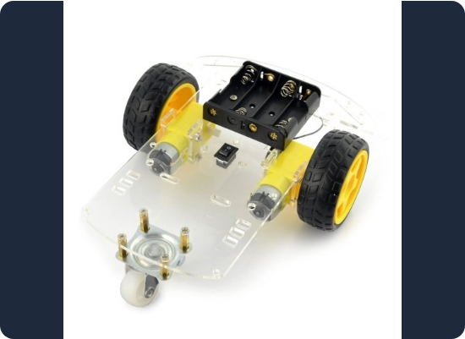
STEERING LOGIC
Differential Steering
Rather than spinning in place, the system calculates a variable speed for each wheel based on the Joystick X-axis:
Inner Wheel: Speed decreases to act as a pivot point.
Outer Wheel: Speed increases to drive the arc of the turn.
Result: Smooth, realistic vehicle motion.

Slide 9
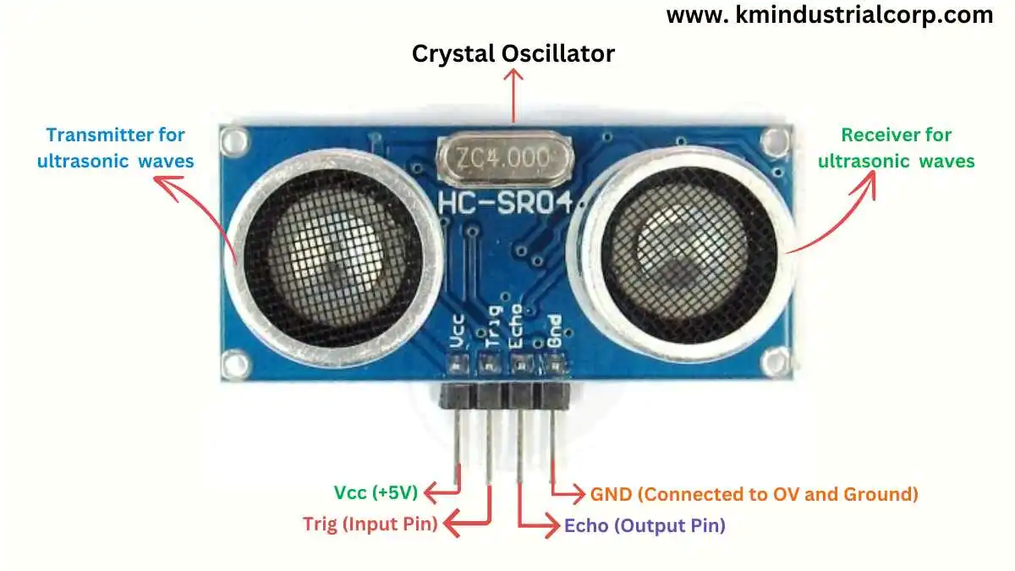


ULTRASONIC SENSING LOGIC
The sensor uses high-frequency sound waves to measure distance. To protect the ESP32, a Voltage Divider (1kΩ and 2kΩ resistors) scales the 5V Echo signal down to a safe 3.3V level.
*0.034 represents the speed of sound in cm/μs.

Slide 10
COLLISION PREVENTION
Safety Protocol
15
Instant Halt: If distance < 15cm, the ESP32 overrides user commands and brakes all motors.
Audible Alert: The GPIO 25 triggers the active buzzer to notify the operator.
Centimeters (Threshold)
Lockout: Forward motion remains disabled until the obstacle is cleared or the robot is reversed.

Slide 11


SOFTWARE & CODE
Web Server
Main Loop
Asynchronous web server hosting HTML/JS resources directly from ESP32 Flash memory.
Real-time polling of distance sensor interleaved with user command execution.

Slide 12
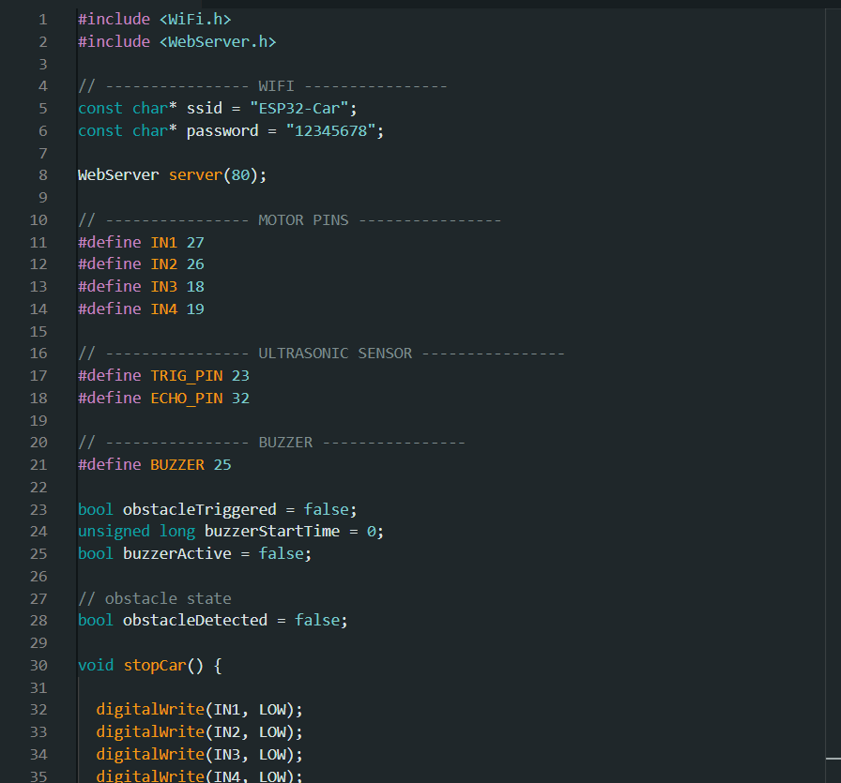
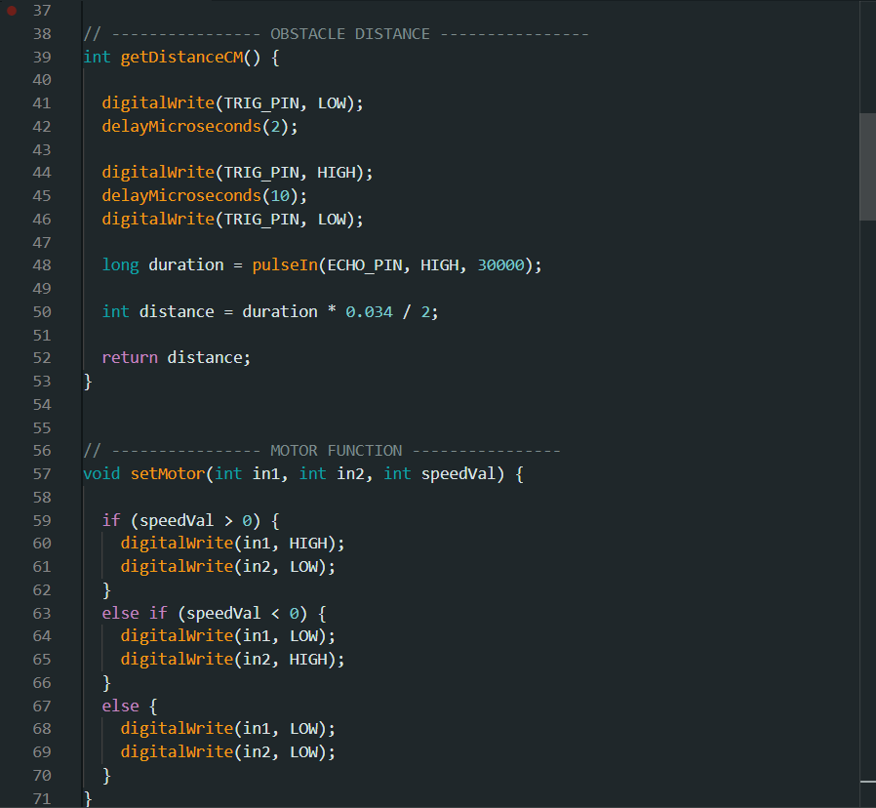
Source Code Highlights

Slide 13
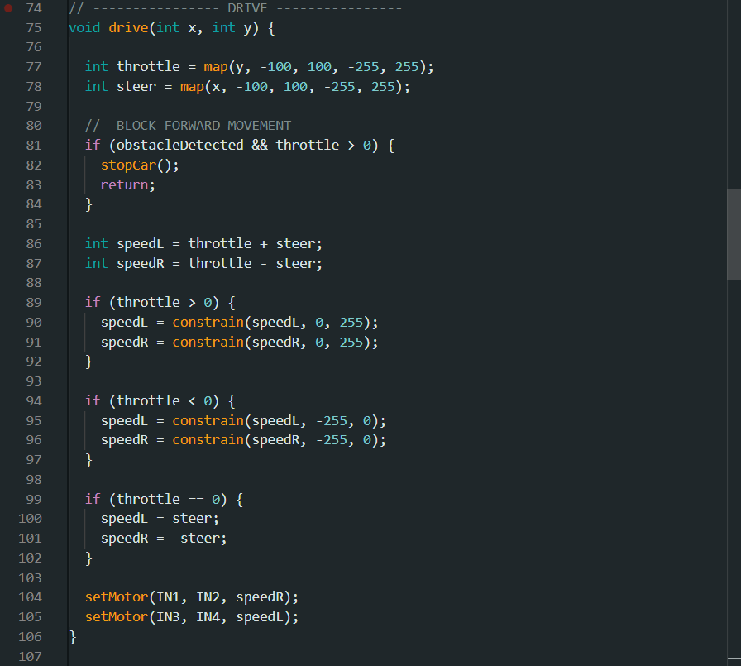
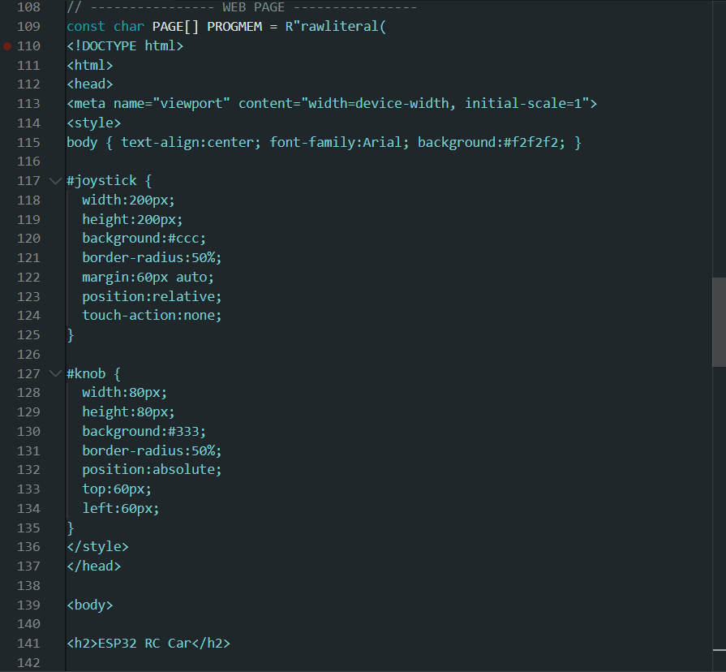
Source Code Highlights

Slide 14
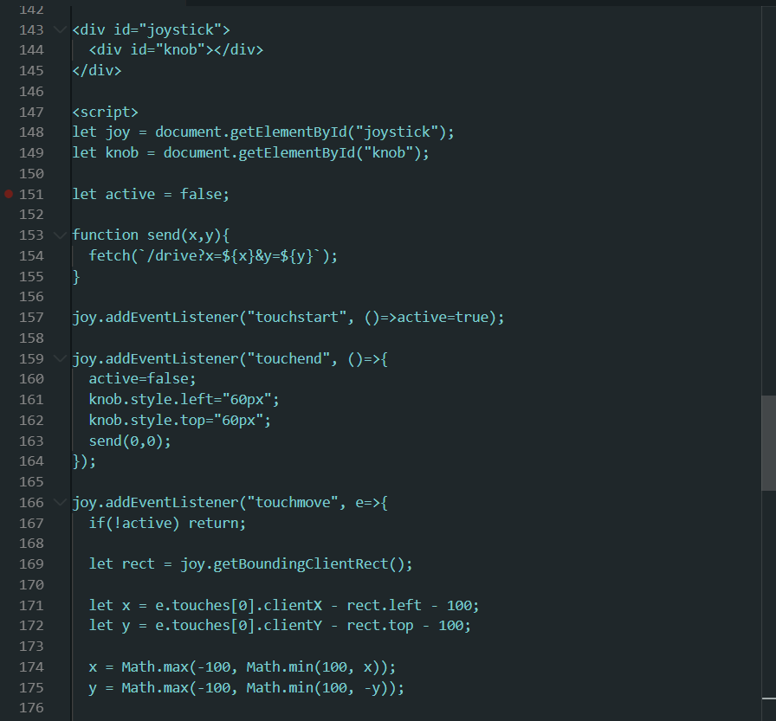
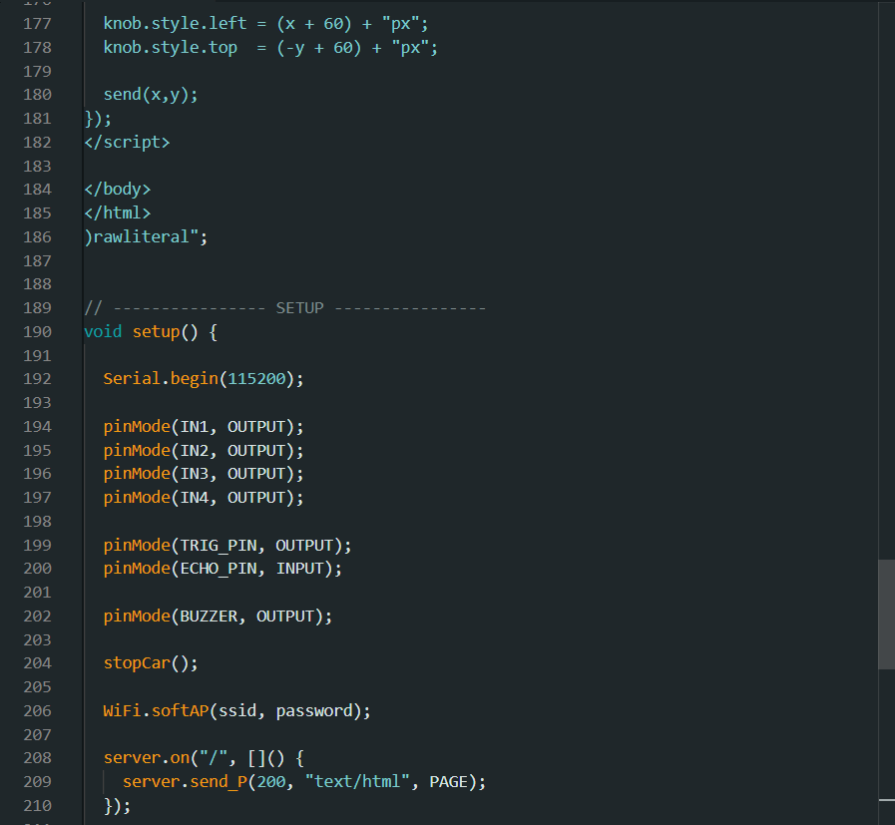
Source Code Highlights

Slide 15
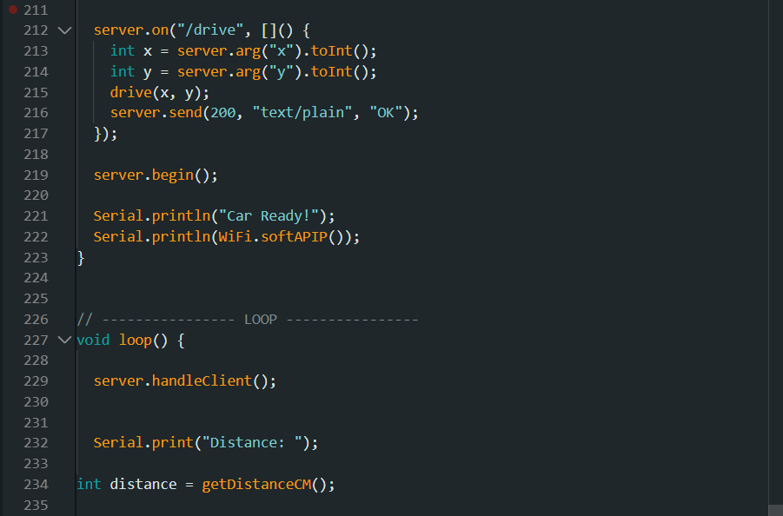
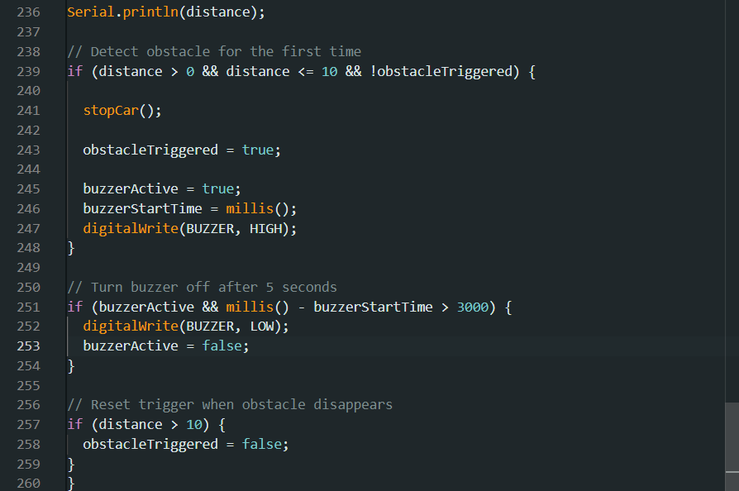
Source Code Highlights

Slide 16


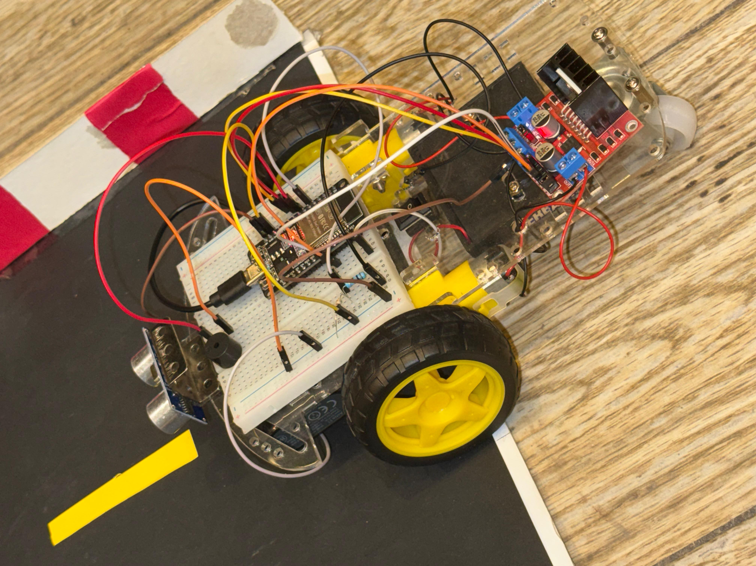

Robot Assembly Photos
[INSERT FINAL ASSEMBLY PHOTOS HERE]

Slide 17

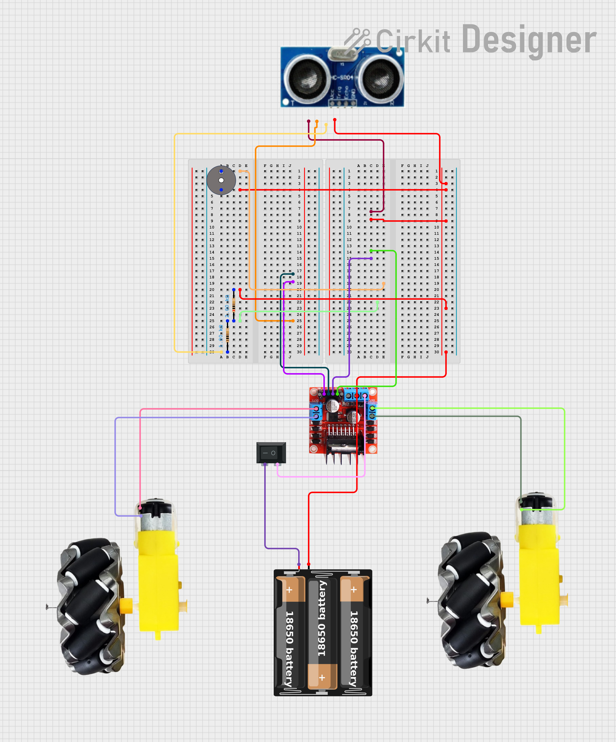

CIRCUITRY & WIRING

Slide 18
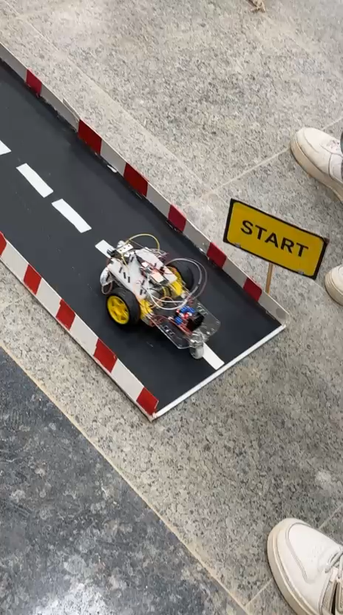
System Demonstration
Live Testing and Functional Verification
Thank you! Questions?

